Slide 1
CRISPR-based Diagnostics for Flu using CARMEN
By Jimma Liddell, MS

Slide 2
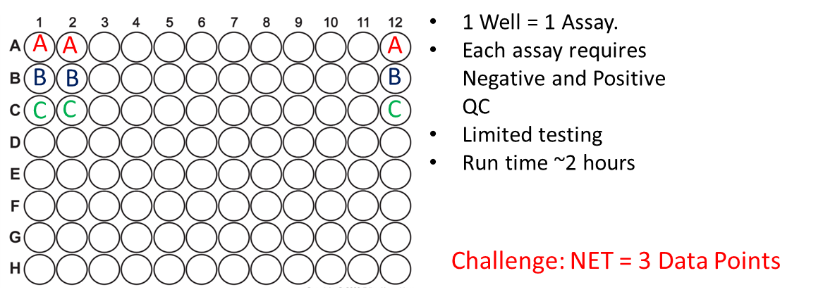
Current Process Challenge…
Can we convert our IVD RT-PCR assays into CRISPR technology to increase the throughput of viral detection as an updated diagnostic method?
Stage 1
Stage 2
Stage 3
Requires Optimal Cycling conditions
95°C
95°C
50°C
2:00
0:15
55°C
0:30
30:00
Challenge: Each Assay Design requires specific run conditions
Reps: 1
Reps: 1
Reps: 45

Slide 3
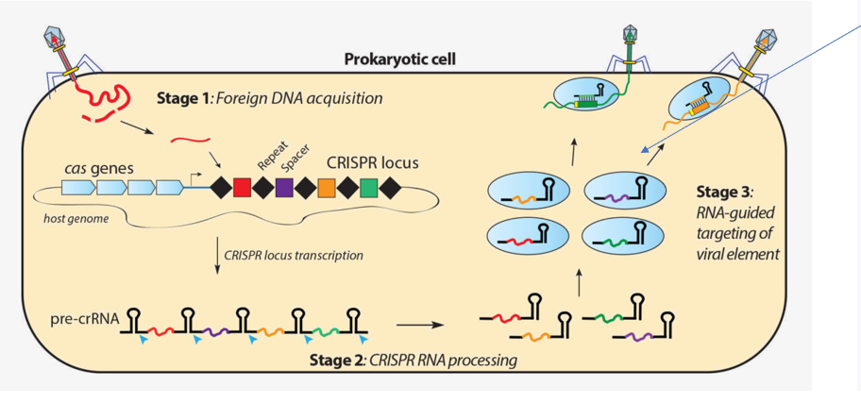
CRISPR Overview
Clustered Regularly Interspaced Palindromic Repeats
Confer Adaptive immunity
After viral infection, invader DNA is integrated into host loci with CRISPR Associated proteins (CAS).
This CAS system is complexed with an endonuclease.
Upon re-infection, the complex and the endonuclease to target the invader, the DNA is cleaved, and Immunity is conferred.
Different CRISPR-CAS Classes = Different nuclease activity target and activity.

Slide 4
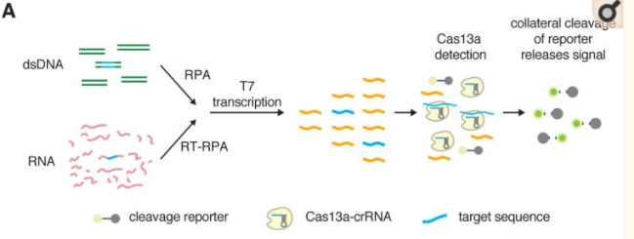
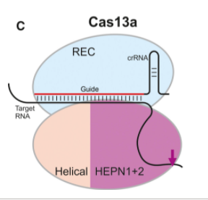
Viral Detection with CRISPR
Collateral cleavage of reporter releases signal
Figure From: Patrick Schindele et al. FEBS press. Jun;592 (12). 2018.
Figure From: Jonathan S Gootenberg et al. Science. Apr 28;356(6336):438-442. 2017
Cas13 is an RNA-guided RNase
Single Nucleotide mismatch
Cleaves surrounding RNA with collateral RNase activity
Guide RNAs can be developed to detect different pathogens or mutations within a pathogen
Specific High-Sensitivity Enzymatic Reporter UnLOCKing (SHERLOCK)
Fluorophore labeled nucleotides are released from their Quencher and produce a quantifiable light emission.
Rapid response Time (~1 hour)
Portable
Can be Multiplexed with lower throughput.

Slide 5
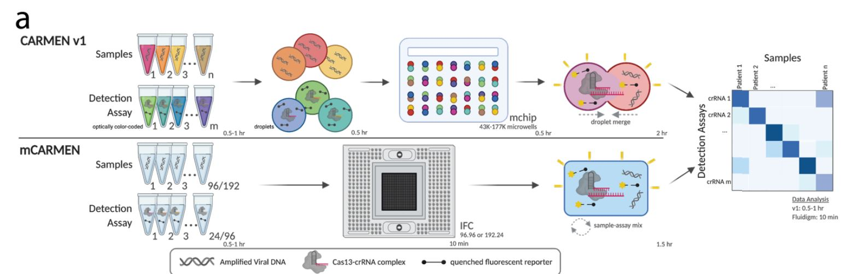
High Throughput updates
Combinatorial Arrayed Reactions for Multiplexed Evaluation of Nucleic Acids (CARMEN) - BROAD
Multiple pathogens are detected in a multiplexed detection system.
The pooled samples are differentiated via oil droplet emulsion.
Microfluidic CARMEN (mCARMEN) – BROAD
Uses a Fluidigm (Standard Biotools) chip to Multiplex multiple assays onto one integrated fluidic circuit (IFC) chip.
Data is compiled in a heatmap, and can be quantified through code

Slide 6
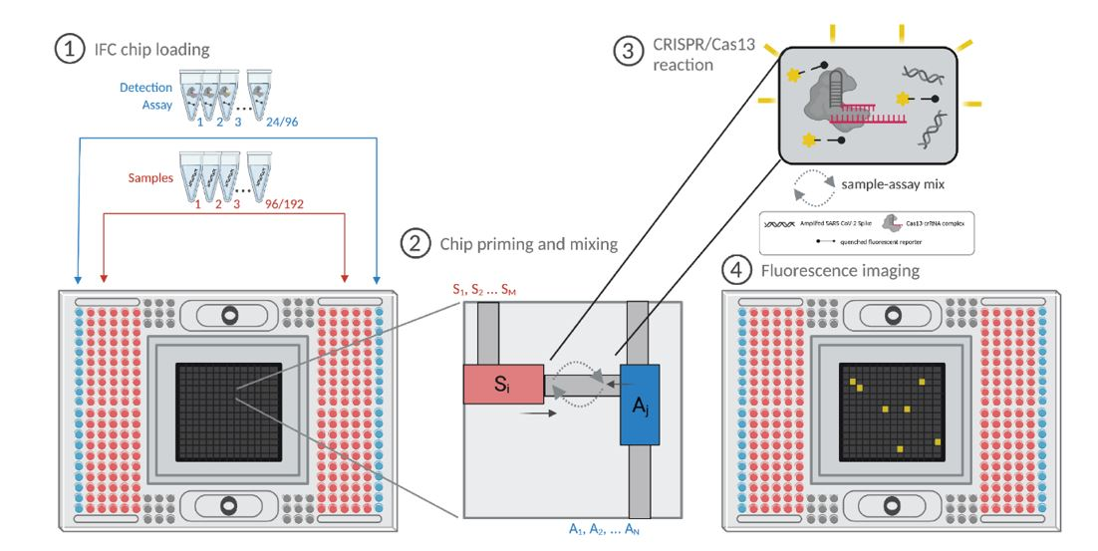
Standard Biotools (FluiDIGM) IFC chip
Capacity:
192 Samples
24 Assays

Slide 7
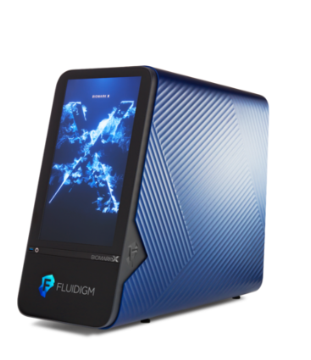
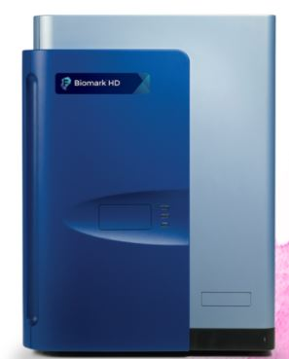
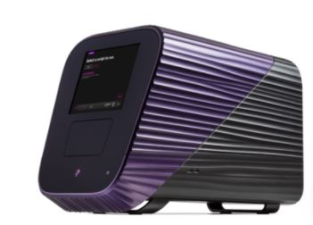
Instrumentation updates
BioMARK HD
BioMARK X
JUNO
+
JUNO mixes samples and assays into the center of the chip + BioMark HD reads fluorescence and collects all data for analysis.
~30 minutes for JUNO, reaction is active upon completion.
Manual Removal to Biomark for final [insert time of run].
BioMARK X combines the IFC controller of the JUNO and the Biomark HD.

Slide 8
Data Analysis
Quantitative data from the BioMARK is converted to a HeatMap for easy visualization.
HeatMap is a quick check on normalized FAM signal. The stronger the color, the more FAM was detected.
GDT is working on optimizing python analysis scripts to work for Flu CRISPR-Dx development.
Specimen Positivity
Assay

Slide 9
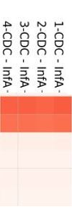
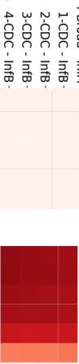
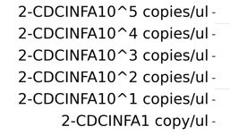
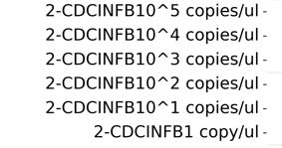
A promising start…
GDT-Developed CARMEN Assays
InfA
InfB
Our initial test involves testing the Influenza A and Influenza B kits…
We need to compare our sensitivity with serial dilutions in comparison to our IVD RT-PCR kits.
We then need to test inclusivity, exclusivity, replication, and testing clinical samples.
TWIST Input Material
(total input copy number)
1,000,000 copies InfA genome
100,000 copies InfA genome
10,000 copies InfA genome
1,000 copies InfA genome
100 copies InfA genome
10 copies InfA genome
1,000,000 copies InfB genome
100,000 copies InfB genome
10,000 copies InfB genome
1,000 copies InfB genome
100 copies InfB genome
10 copies InfB genome
Yellow highlight = sensitivity of RT-PCR assay

Slide 10
Summary of advantages
Time Conservation
Comparable Run=time
ASSAY compilation
More Assays at a time (24 Assays).
Data output
More Data points generated per run (192 Samples).
Universal Run conditions=Easy swap in access in cases of mutation or new pathogen.
Emergency Use
High Throughput Detection
Room for testing multiple guide RNAs detecting a pathogen with a diverse genome
Potential Challenges
Cost
Cost of consumables may be challenging for public health budgets (but cost per reaction is very low)
Learning Curve*
Accurately Loading the IFC chip is tedious. Bubbles = no data reads.
*Solution??
Accessibility
State Lab/Hospital Access is limited

Slide 11
Acknowledgements
Broad Institute
Pardis Sabeti
Nicole Welch
Hayden Metsky
Jeremy Johnson
Marzieh Mirhashemi
Princeton University
Cameron Myhrvold
GDT
John Barnes
Marie Kirby
Malania Wilson
VSDB
David Wentworth
Lindsay Culp

